Slide 1
SWEN90016 Software Processes & Project Management
Risk Management
2019 – Semester 1
Tutorial 8
Copyright University of Melbourne 2017

Slide 2

Today’s aim
Understand Risk Management
for Language Research project

Slide 3
That’s interesting!
IBM (2008): 40% of IT projects meet schedule, budget, & quality goals
KPMG (2013): a third of the IT spend for an organization delivers the desired results
XDNET (2009): estimate that the cost of failed IT projects are as high as $6 Trillion worldwide
http://www-935.ibm.com/services/us/gbs/bus/
pdf/gbe03100-usen-03-making-change-work.pdf
https://www.kpmg.com/NZ/en/IssuesAndInsights/ArticlesPublications/Documents/KPMG-Project-Management-Survey-2013.pdf
http://www.zdnet.com/blog/projectfailures/
worldwide-cost-of-it-failure-6-2-trillion/7627
Notes:
Notable failures

Slide 4
Have you been paying attention?
Risk Quiz
Answer the following six questions

Slide 5
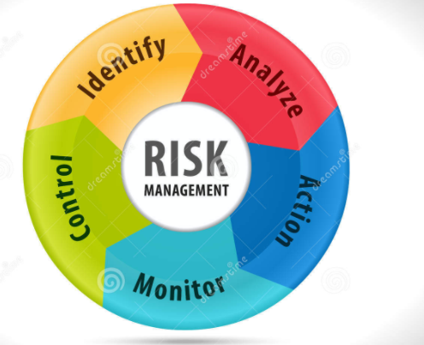
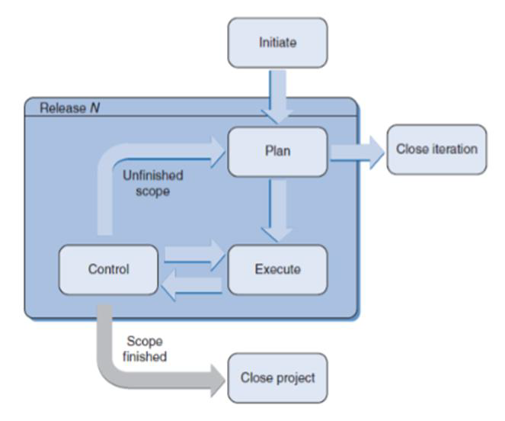
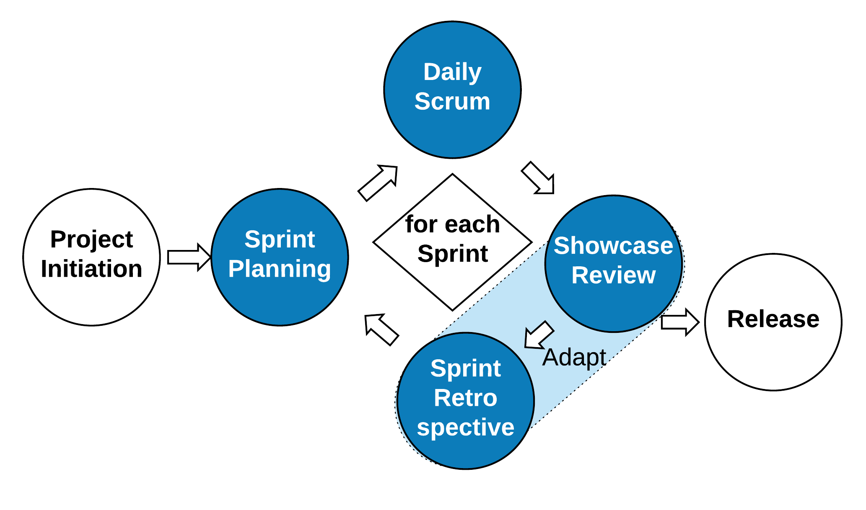
Getting Started
1.
Define Project Risk
PMBOK
2.
In what PM phase does
Risk Management start?
Risk Management
From Lecture 8, slid 13
http://blog.zilicus.com/software-project-management-activities-roles/

Slide 6
Risk Management example
For the Language Research Case Study
Some key characteristics are:
data integration from several distributed resources in several different formats. One feature of the system is to resolve the differences between idiosyncratic data formats.
sharing modules in a distributed environment, choose between a local installation which will generate multiple copies, or a central installation with remote access
- peer-to-peer control strategy

Slide 7
Identify: Brainstorm
Brainstorm all risks for the project.
Nominate new ideas
No filter!

Slide 8
Analyze
Evaluate probability, impact & priority
Sift through all the risks in the project
Review and debate their importance
3.
What are the top three/four risks to be controlled?
Document in a table.

Slide 9
Analyze: Risk Register
4.
Create a risk register to document the controlled risks for your project
Id | Risk Description
Risk 1
Risk 2`
Risk 3

Slide 10
Analyze
5.
Calculate: :probability impact exposure
Risk | Probability of Risk | Size of Loss (Days) | Risk Exposure (Days)
Risk 1
Risk 2`
Risk 3
the impact to the schedule if the risk did occur
Risk probability = a measure between 0 and 1 inclusive
Risk impact = finite grade of 1-5 scale, such as:
(1) none; (2) minimal; (3) moderate; (4) severe; (5) catastrophic impact;
monetary cost or time cost?
Risk exposure = probability × impact

Slide 11
Analyze
5.
Calculate::probability impact exposure
Risk | Probability of Risk | Size of Loss (Days) Out of 30 days total For 6 week project | Risk Exposure (Days)
Risk 1 –Flat priority causes ineffective automation | 10% | 5 days Moderate - 3
Risk 2` Data security | 5% | 15 days Severe - 4
Risk 3 – dev team delay | 25% | 2 days Minimal - 2

Slide 12
Respond, Monitor & Control
Add Response strategy for handling threats & opportunities
Monitor Process
Lecture 8: slide 50

Slide 13
Agile Risk Process
What
Where
Who
When
Why
Sprint Review risk evaluation
Build small piece of working software with minimal features
Showcase the product chunk to the stakeholders early
Fail fast and as cheaply as possible, & get timely feedback
Capture the risk item in the Product Backlog
The Product Owner sets the priority of the risk item
Refer to: Tutorial 5_procurment:Change Control, slide 20

Slide 14
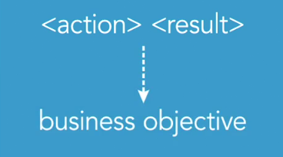
Agile Risk Process
Sprint Review risk evaluation
The format of a risk item in the Product Backlog can vary
Optionally use Feature-Driven Development (FDD) syntax,
(when the role is not obvious)
Example.
Risk 1: include request priority, for an effective booking service
www.mountaingoatsoftware.com/blog/not-everything-needs-to-be-a-user-story-using-fdd-features

Slide 15
Control
6 a.
What are the key differences in characteristics between the
Formal-incremental and Agile-iterative SDLC?
b.
How would these characteristics influence risk management?

Slide 16
Thank You!

